Slide 1
Co-expression Study Analysis of two Potential biomarkers in Pancreatic Cancer Patient samples using R coding language.
Jannatul Shoma

Slide 2
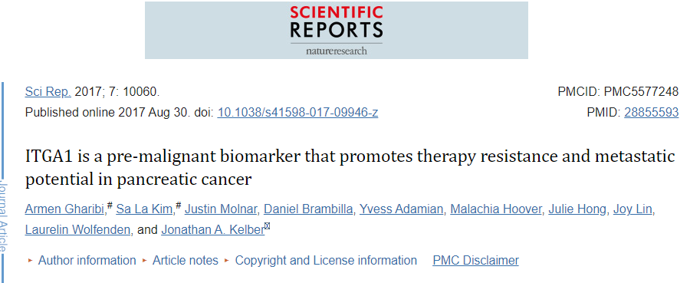
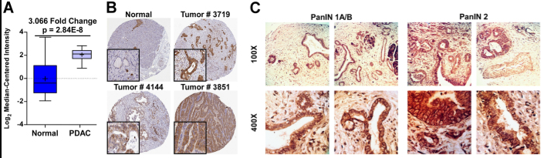

Slide 3
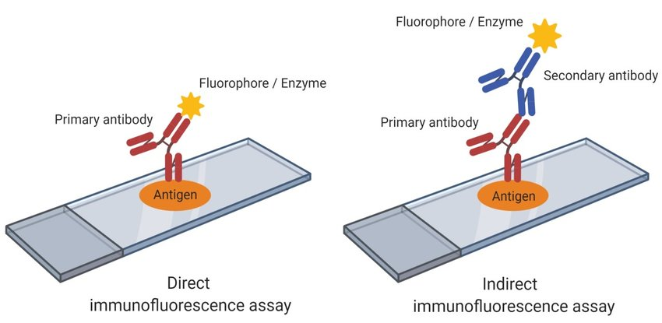
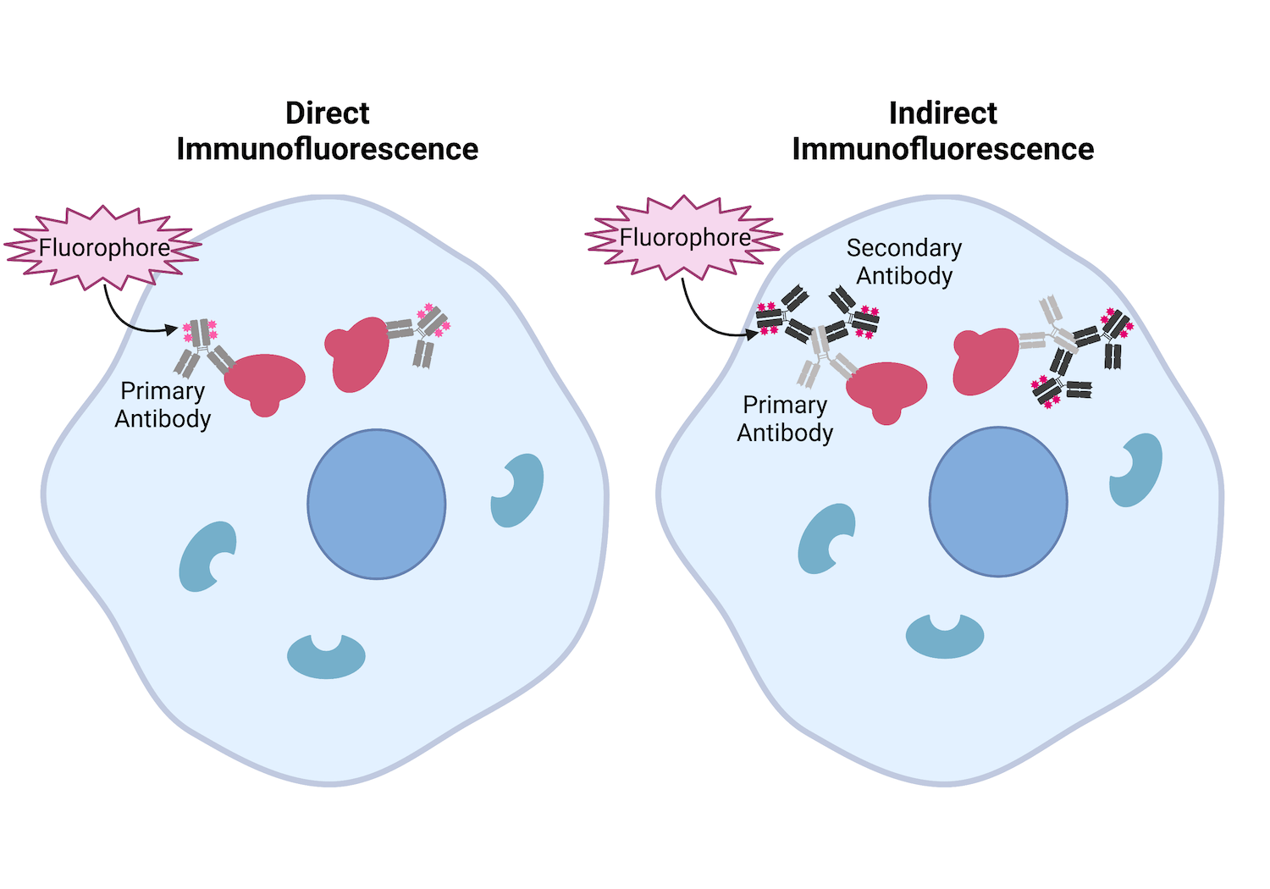
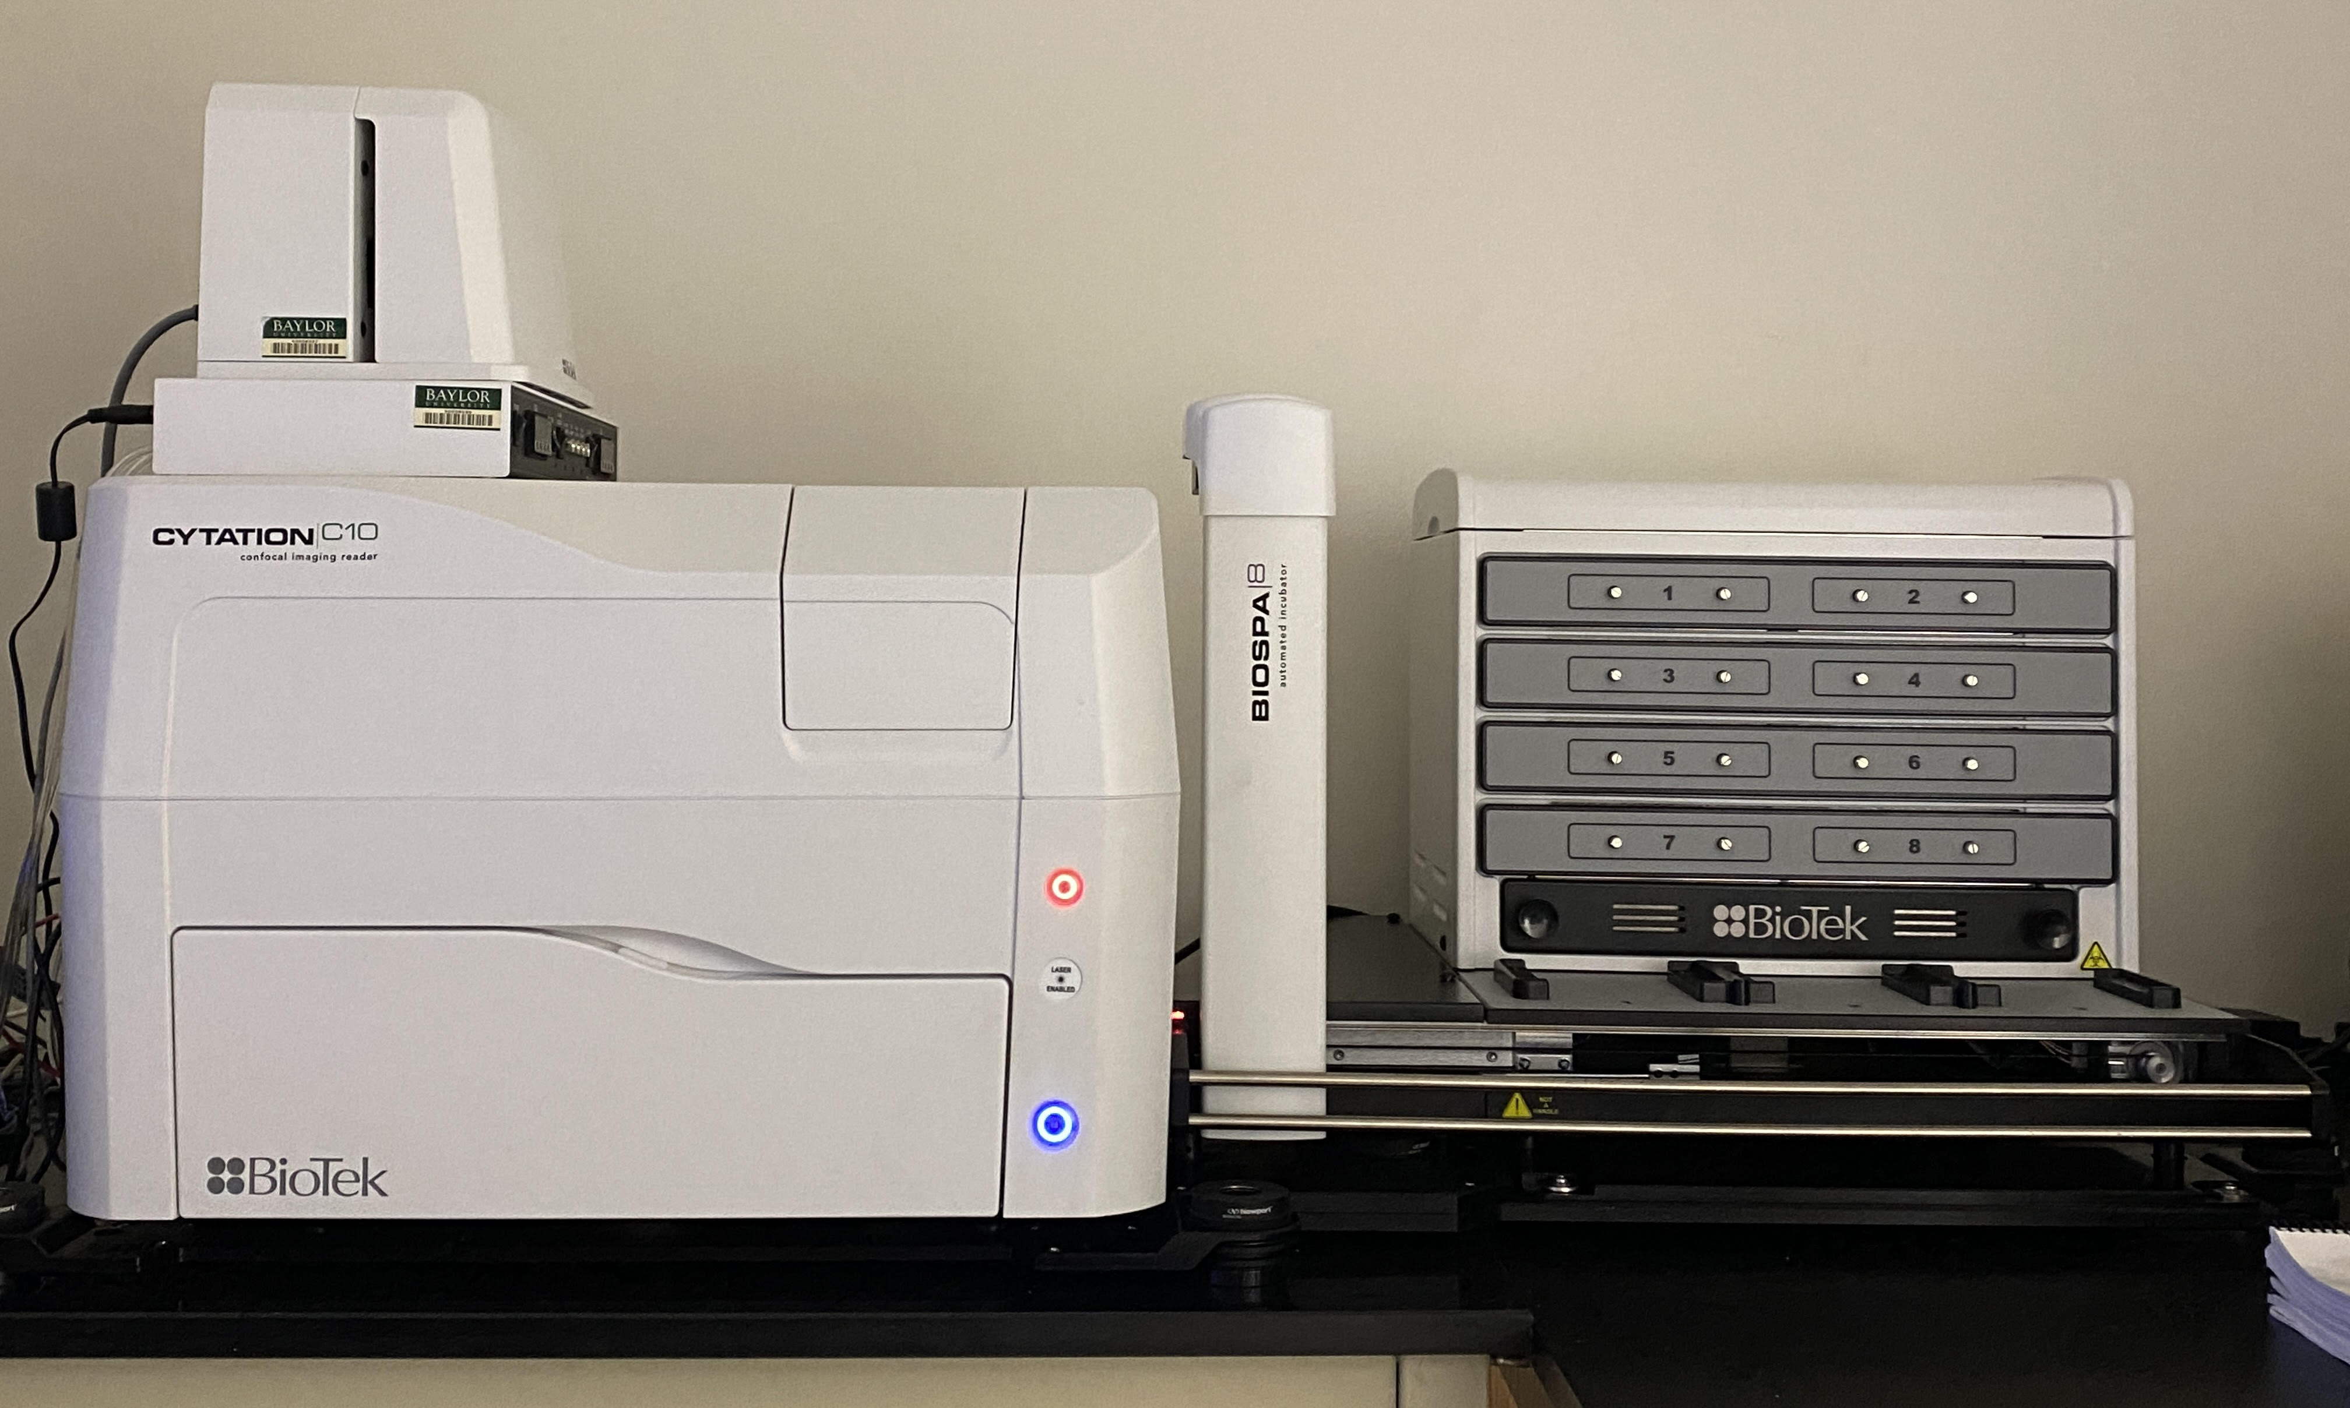
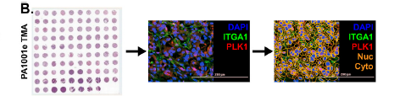




Workflow of the Analysis

Slide 4
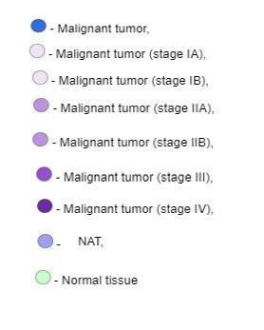
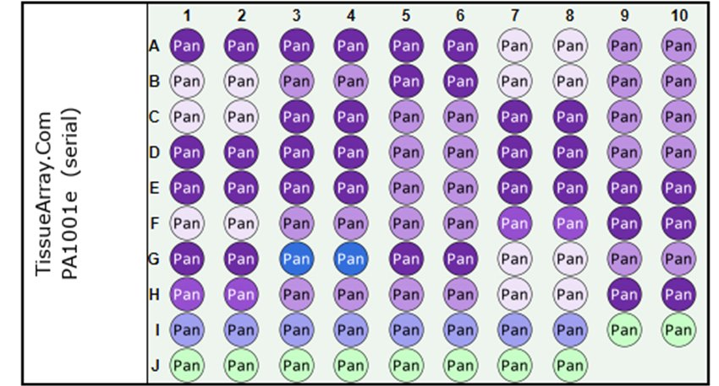
Tissue Microarray arrangement

Slide 5
Questions
What is the Frequency Distribution of nuclear area per tissue section of the pancreatic cancer patient samples?
How do the Protein1 and Protein2 staining correlate within the Tumor cell compartments of the Pancreatic Cancer patient samples?
Is there a significant Difference in their correlation between the expression levels of these proteins in Normal vs Pancreatic Cancer Cells?

Slide 6
Install and load the packages
install.packages("readxl")
install.packages(“dplyr”)
install.packages(“ggplot2")
library(readxl)
library(dplyr)
library(ggplot2)

Slide 7
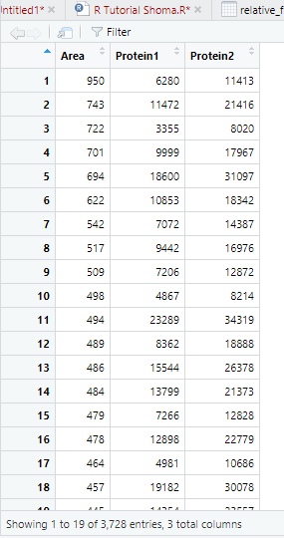
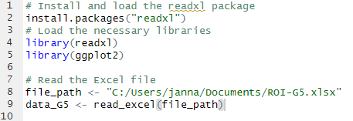
Read the Excel File

Slide 8
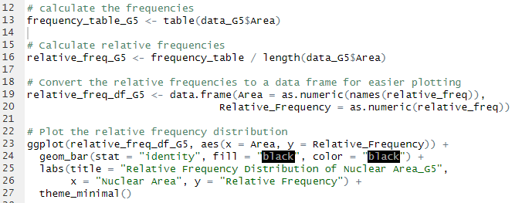
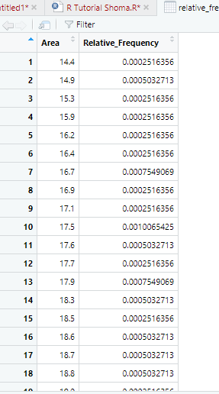
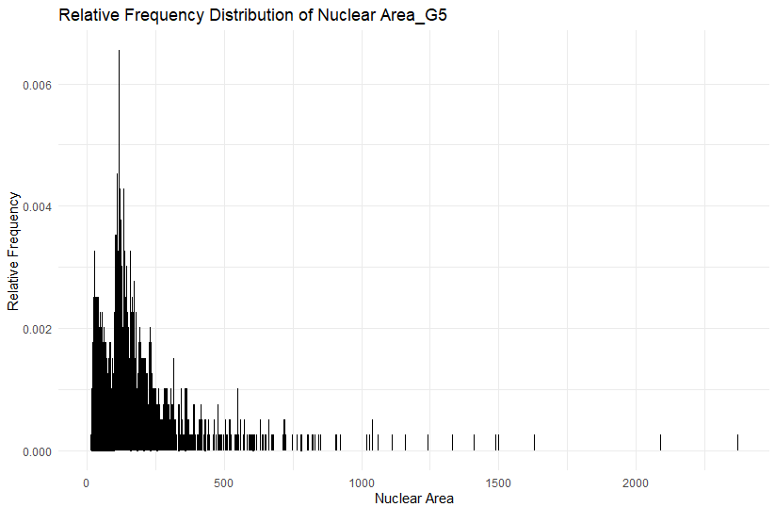

Slide 9
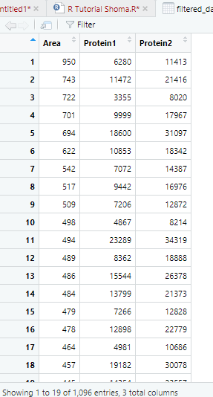
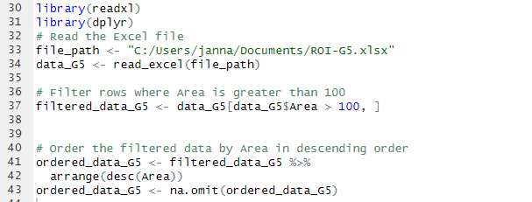
Isolating Tumor cells from Normal Cell

Slide 10
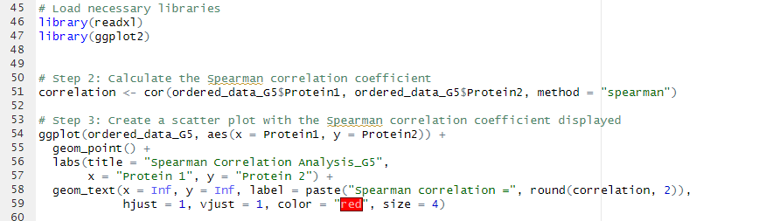
Spearman Correlation Analysis of Protein1 and Protein2 in Pancreatic Cancer Cells

Slide 11
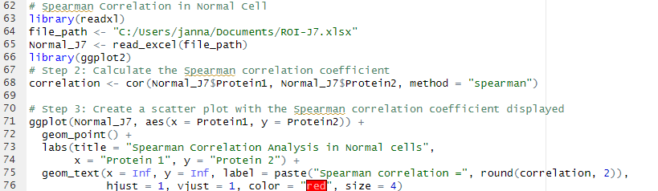
Spearman Correlation Analysis of Protein1 and Protein2 in Normal Cells

Slide 12
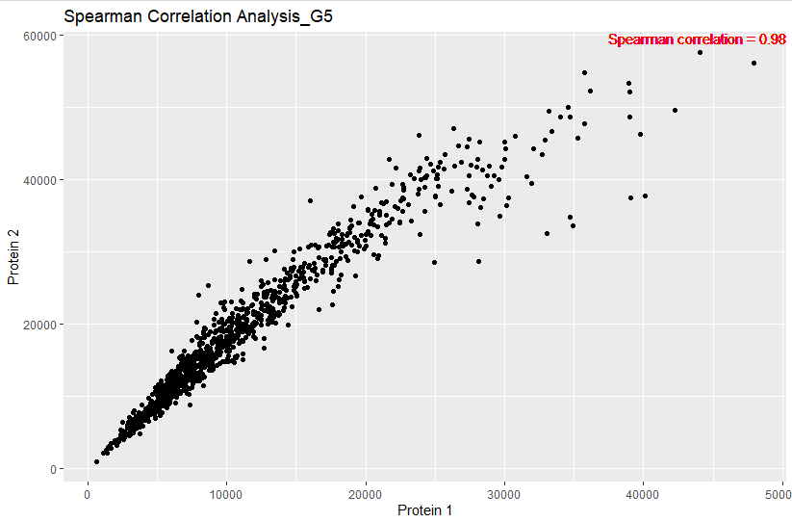
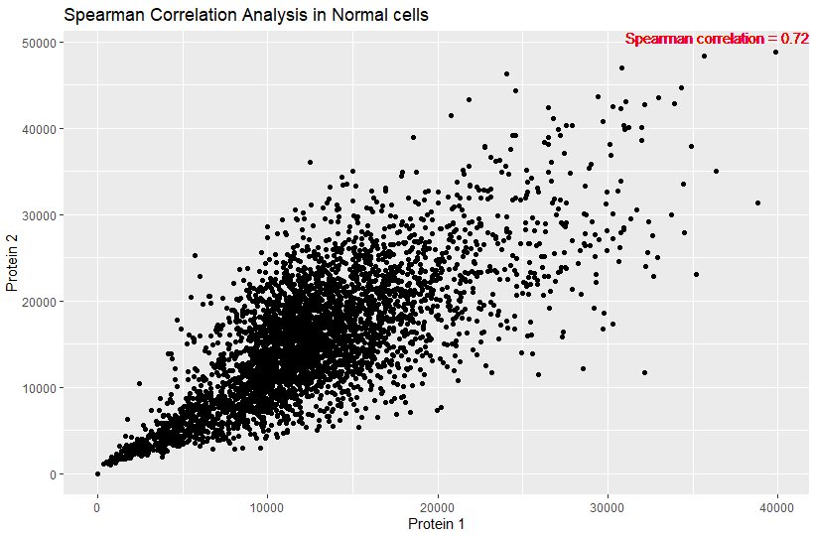
Comparing the Experimental and Control Plots

Slide 13


